Slide 1

Anonymity in XIA
Nicolas Feltman
David Naylor

Slide 2
Goals
Examine existing methods
Does XIA break anything?
Explore new methods
What new things does xia let us do?
Consider interfaces for users and developers
How can we help developers leverage these tools?
How can we help users understand them?

Slide 3
(Brief) XIA Review
Multiple communication principals
e.g., hosts, services, and content
DAG-based addressing
MORE control over routing
graceful implementation of fallbacks
SID
AD
HID

Slide 4


Existing Approach: Proxy
DEST: 187.14.2.1
SRC: 128.144.0.17
DEST: 89.22.22.11
DEST: 89.22.22.11
SRC: 187.14.2.1
REQUEST
REQUEST
128.144.0.17
DEST: 128.144.0.17
187.14.2.1
89.22.22.11
DEST: 187.14.2.1
SRC: 187.14.2.1
SRC: 89.22.22.11
SRC: 89.22.22.11
RESPONSE
RESPONSE

Slide 5
Direct translation to XIA
DEST:
AD_{P}
HID_{P}
SID_{P}
SRC:
DEST:
AD_{C}
HID_{C}
SID_{C}
AD_{S}
HID_{S}
SID_{S}
DEST:
SRC:
AD_{S}
HID_{S}
SID_{S}
AD_{P}
HID_{P}
SID_{P}
REQUEST
REQUEST
C
C
C
DEST:
P
P
P
DEST:
S
S
S
AD_{C}
HID_{C}
SID_{C}
AD_{P}
HID_{P}
SID_{P}
SRC:
SRC:
AD_{P}
HID_{P}
SID_{P}
AD_{S}
HID_{S}
SID_{S}
SRC:
RESPONSE
AD_{S}
HID_{S}
SID_{S}
RESPONSE

Slide 6
DAGs are cleaner
We can directly express our intent:
SID_{P}
SID_{S}
AD_{P}
HID_{P}
AD_{S}
HID_{S}
PROXY
SERVER

Slide 7
DAGs in action
DEST:
DEST:
SID_{P}
SID_{S}
SID_{S}
SRC:
SRC:
AD_{C}
HID_{C}
SID_{C}
AD_{P}
HID_{P}
SID_{P}
REQUEST
REQUEST
C
C
C
DEST:
P
P
P
DEST:
S
S
S
AD_{C}
HID_{C}
SID_{C}
AD_{P}
HID_{P}
SID_{P}
SRC:
SRC:
AD_{P}
HID_{P}
SID_{P}
AD_{S}
HID_{S}
SID_{S}
RESPONSE
RESPONSE

Slide 8
New Approach: Temporary IDs
Use a temp. service ID in place of host ID
Register temp. SID with local AD
Places trust in local AD instead of remote 3rd party
DEST: …
➔
DEST: …
SRC:
SRC:
AD
HID
AD
SID
…
…

Slide 9
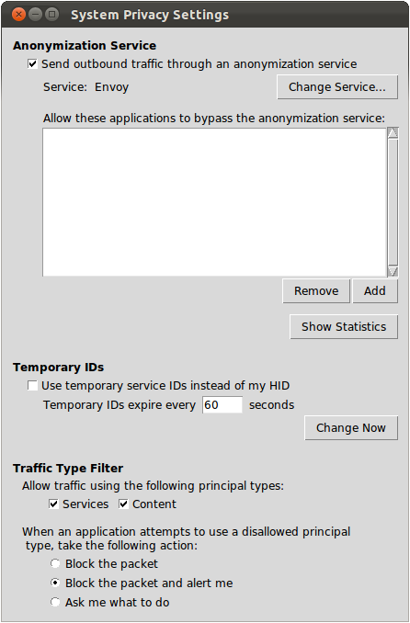
Control and Transparency
Global Controls
Control anonymity
Settings at the OS level
Notes:
Even though it’s not XIA specific, when we’re re-architecting the Internet it’s a good time to build in things users want.

Slide 10
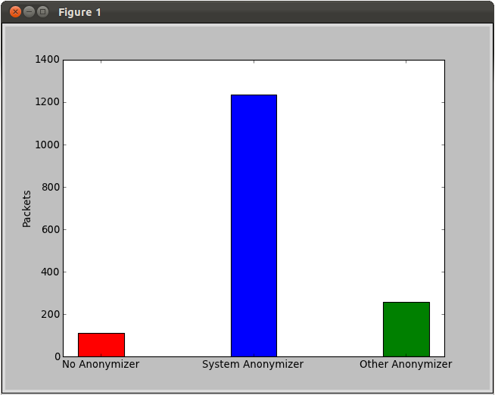
Control and Transparency
Transparency
Users can see exactly
What’s happening
Notes:
Even though it’s not XIA specific, when we’re re-architecting the Internet it’s a good time to build in things users want.

Slide 11
Socket API Extension
Using these tools should be dead-easy for developers
Extend socket API to allow simple setup for anonymous communication
Experienced developers should be able to do more
Applications can request to bypass system anonymization settings
Xconnect(sock, dest_DAG)
XconnectCustomAnonymizer(sock, dest_DAG, anon_DAG)
XconnectWithoutAnonymizer(sock, dest_DAG)

Slide 12
Comparison
 | XIA | TCP/IP
Proxy-based anonymizer | In-DAG or next-header | Next-header
Temporary source IDs | Register SID with local AD Fine-grained: different temp. SID per application | Painful with static IP addresses Coarse-grained: one IP address for all processes on machine
Principal type filtering | Fine-grained traffic control | N/A

Slide 13
Demo

Slide 14
Questions?

